Slide 1

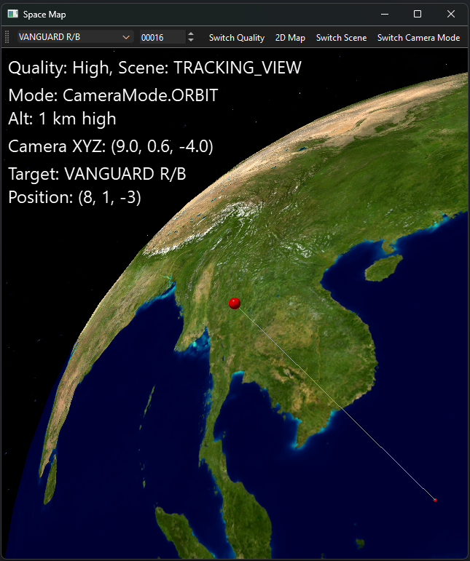
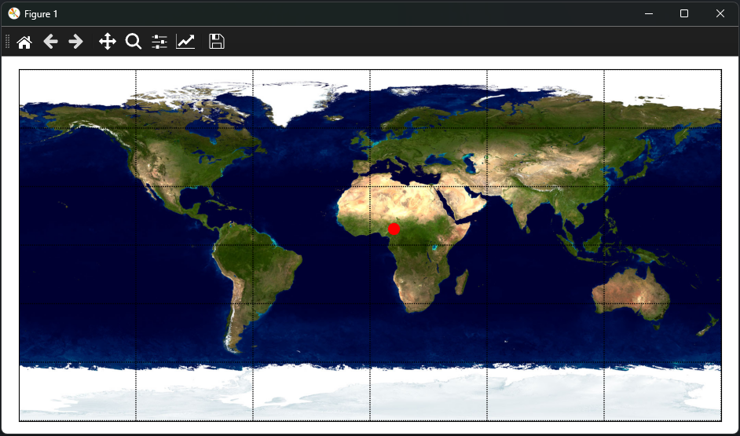
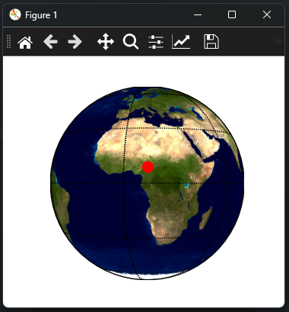
Space-map
Aiden Okrent
Track and visualize satellites in Near-Earth Orbit (NEO) in real-time, using precise orbital data directly from your desktop.
MVC Architecture, 3 camera modes
github.com/aiden-okrent/space-map <

